Slide 1



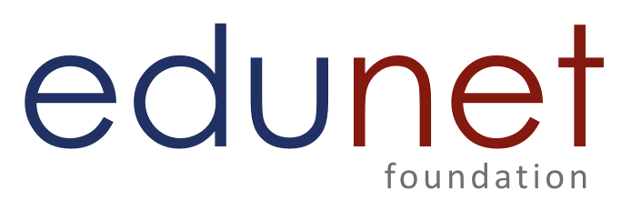
Project: Smart-Nutrition AI: Your Intelligent Nutrition Assistant
Team Members
Syeda Afshan Sultana
Aadil Alanoor Chauhan
Kumar Aditya
Ankit Tiwari
Mohammed Aadil

Slide 2
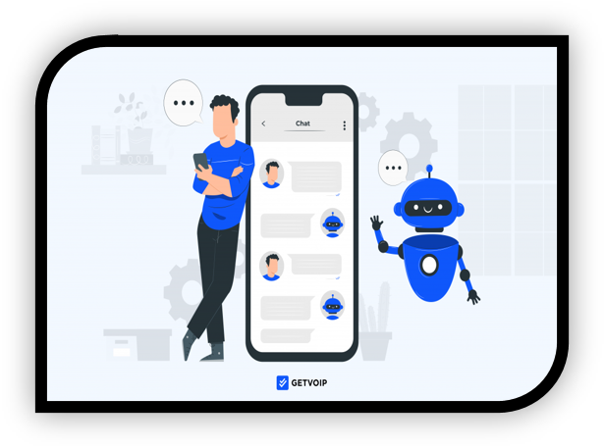
Problem Statement
Problem Identified: Many people lack quick, affordable, and personalized access to nutritional information, leading to poor dietary choices, confusion about healthy eating, and difficulty meeting fitness or health goals.
Proposed Solution: Smart-Nutrition AI offers a user-friendly, multimodal interface (text, voice, and image input) that delivers instant nutritional insights using advanced machine learning, including OCR and speech-to-text.
Target Beneficiaries: The app is designed for health-conscious individuals, fitness enthusiasts, people with dietary restrictions, and busy professionals who need accessible, on-the-go dietary guidance.
Source
https://www.freepik.com/

Slide 3

Solution
Streamlit Web App Foundation: The solution is built using Streamlit, enabling rapid deployment and an intuitive, user-friendly interface for seamless interaction.
Multimodal Input Options: Users can engage with the app through text typing, voice queries (converted using speech-to-text), or image uploads (analyzed using OCR for food label extraction).
Generative AI-Powered Analysis: All inputs are processed using Google’s Gemini 1.5 Flash model to generate detailed, intelligent responses tailored to the user's nutrition-related queries.
Context-Aware Insights: Whether the user is seeking meal suggestions, diet planning, or evaluating food items, the system delivers relevant, personalized recommendations in real time.
Feature-Ready for Growth: With built-in modules like a “Meal Planner” and a “Feedback” section, the application is designed for continuous evolution and deeper user engagement.
.

Slide 4


Project Demo
https://github.com/aadilchavhan/smartnutrition-ai.git
Source
https://www.freepik.com/
Notes:
The demo showcases an AI-powered platform that provides NSTI trainees with:
Instant query support through AI chatbot
Personalized study material recommendations
Step-by-step problem-solving assistance
Real-time progress tracking and analytics
It ensures 24/7 academic support and enhances the overall learning experience.
The AI-powered NSTI Study Resource Helper provides verified study materials, understands trainee queries, adapts to learning styles, and updates content based on performance, ensuring personalized and effective skill-based education.
Demo website - NSTI Study Resource Helper | Microsoft Copilot Studio

Slide 5
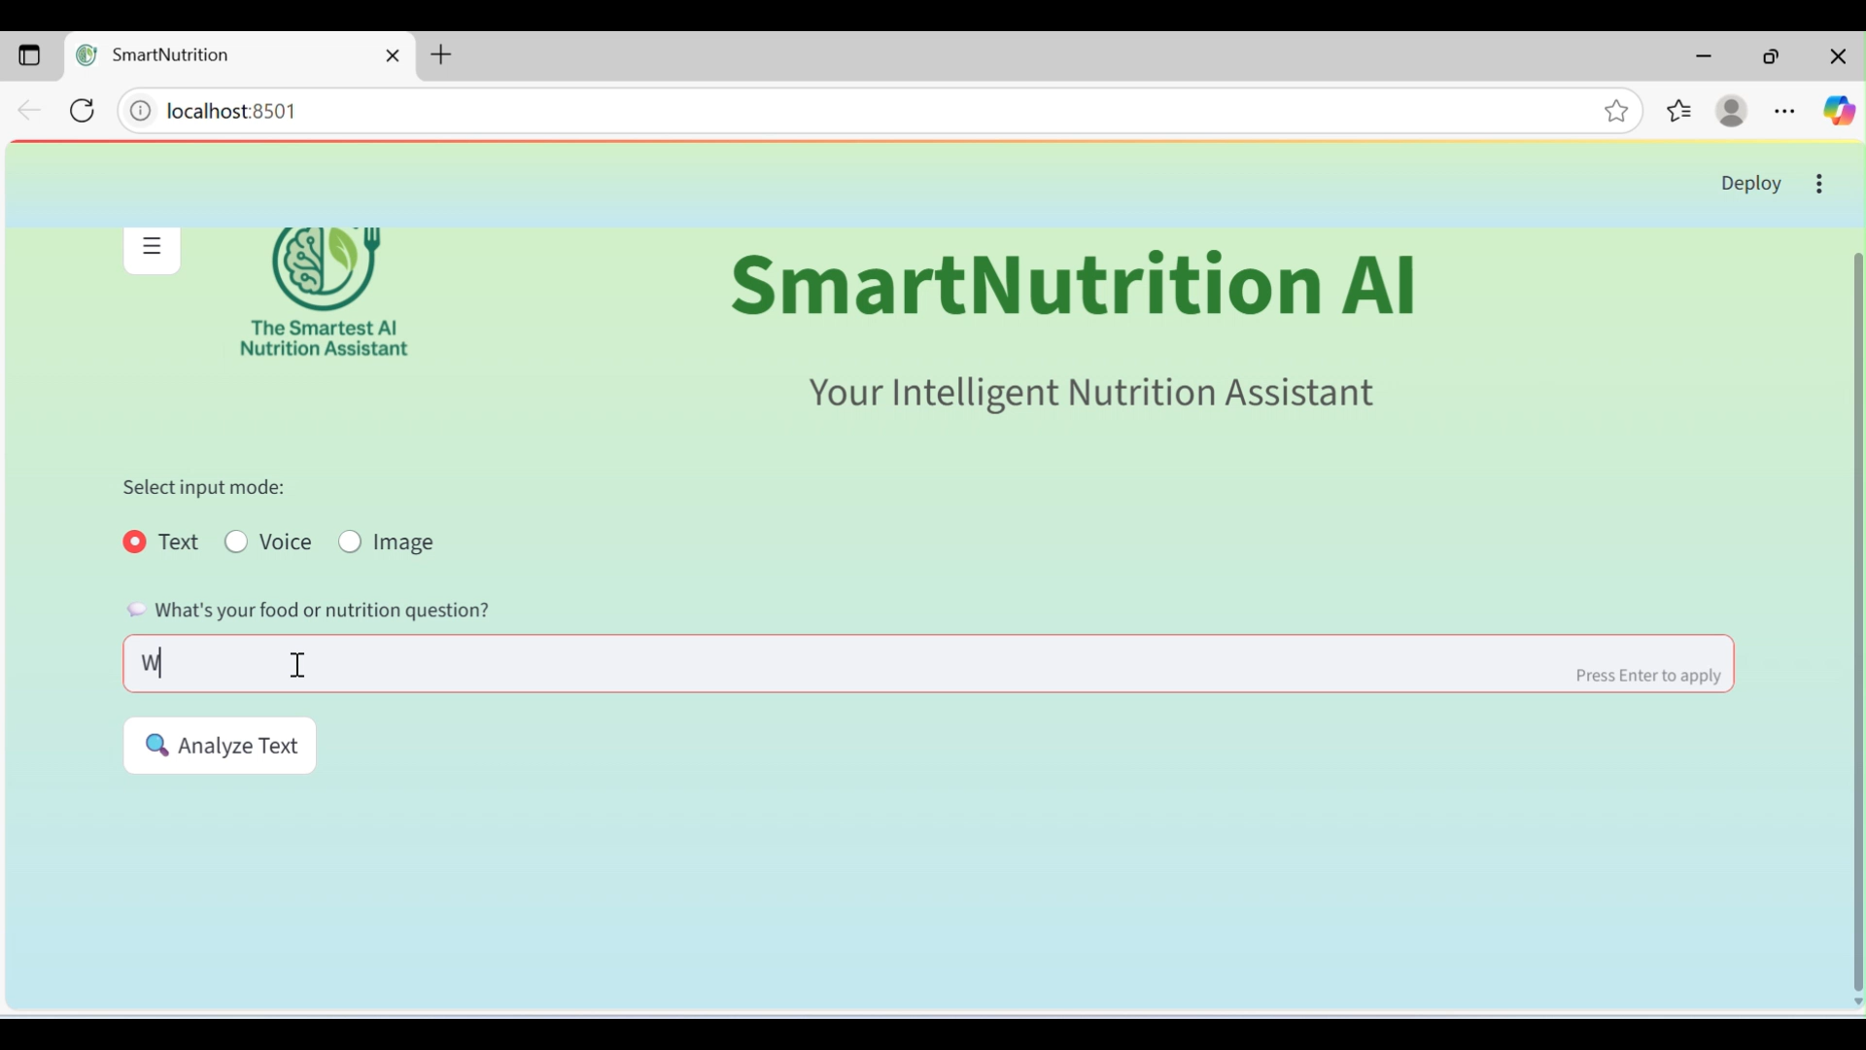
Project Video​

Slide 6

Future Scope
Strong Multimodal Performance: Smart-Nutrition AI’s integration of Google Gemini 1.5 Flash with text, voice, and image inputs resulted in accurate, personalized nutrition responses, enhancing accessibility and user experience. .
Areas for Improvement: OCR accuracy can be inconsistent with low-quality images, voice input flow needs smoother UX (e.g., hands-free activation), and the “Meal Planner” feature remains incomplete.
Ambitious Enhancements Planned: Future improvements include vision-based food recognition, barcode scanning, personalized dietary profiles, recipe generation, and real-time tracking via wearable integrations.
User-Centered Growth Vision: Plans to improve mobile responsiveness, enable continuous voice listening, implement meal planning features, and create a feedback database will support ongoing usability and data-driven evolution
Source
https://www.freepik.com/

Slide 7
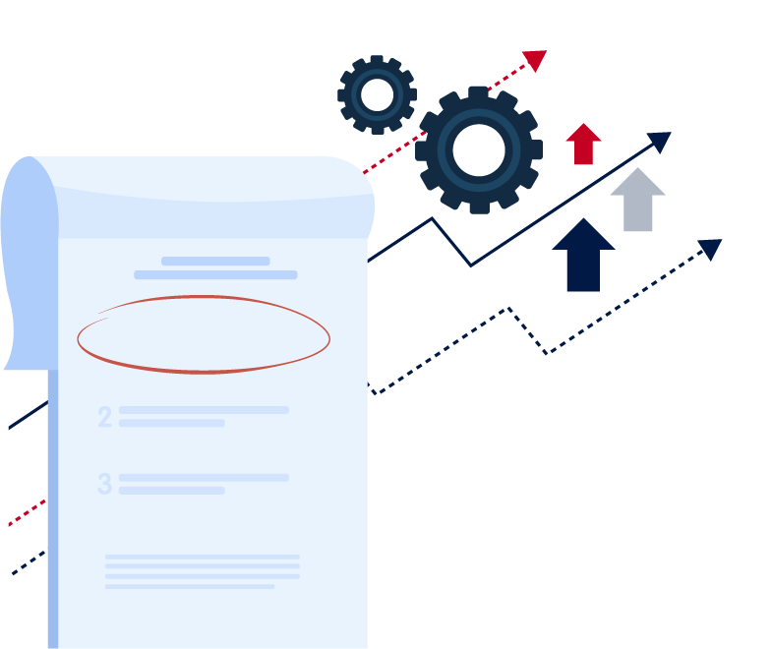
Conclusion
Smart-Nutrition AI is a forward-thinking webpage that fuses cutting-edge machine learning technologies to revolutionize how individuals access and interpret nutritional information.
By unifying generative AI, OCR, and speech-to-text in a streamlined, multimodal interface, it empowers users with fast, intuitive, and personalized nutrition guidance. Built using Streamlit for rapid development and a seamless user experience, it harnesses Google's Gemini 1.5 Flash to deliver context-rich and accurate recommendations.
As health awareness continues to rise globally, Smart-Nutrition AI stands well-positioned to scale through features like automated meal planning, tailored dietary tracking, and multilingual support, the platform is set to evolve into a comprehensive digital nutrition companion for modern lifestyles.
Source
https://www.freepik.com/

Slide 8

Thank you!
Notes:
Reference
These are the references for this session.
8

